Slide 1
Management and Post-Processing of Prostate Perfusion MRI
Medical Imaging Course
Ali Mirzai & Guillaume Lemaître

Slide 2
Outline
Introduction
Algorithm description
Results
Improvements

Slide 3
Outline
INTRODUCTION
Algorithm description
Results
Improvements

Slide 4
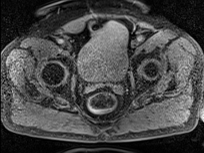
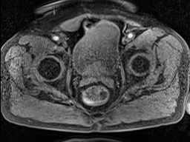
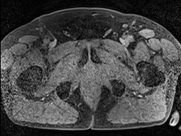
Introduction
Data representation
time t
time t
time t
n slices

Slide 5
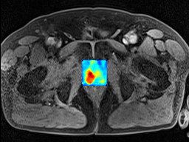
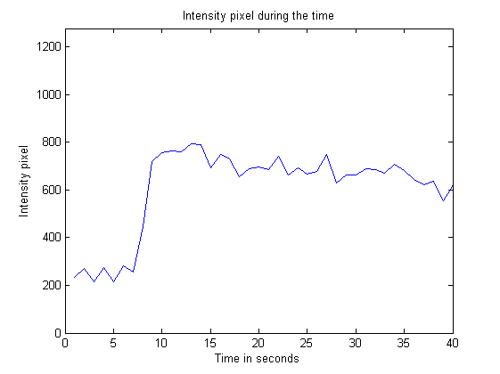
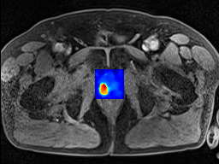
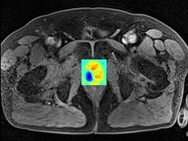
Introduction
Data representation
Compute the different parametric images:
Maximum Contrast Enhancement
Wash – In
Wash - Out
MCE
Algorithm
Wash - In
Pixel (i,j) in slice k
Slice k
Wash - Out

Slide 6
Outline
Introduction
ALGORITHM DESCRIPTION
Results
Improvements

Slide 7
Algorithm description
Parameters computation
Injection time computation
Maximum computation
Global maxima
Local maxima
Parametric maps computation
Maximum Contrast Enhancement image
Wash – In image
Wash – Out image
Combination of parametric images

Slide 8
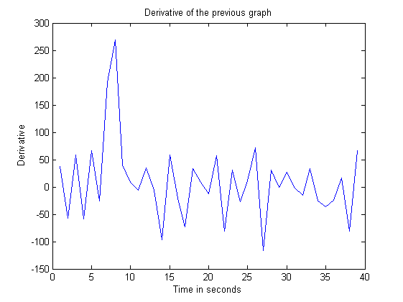
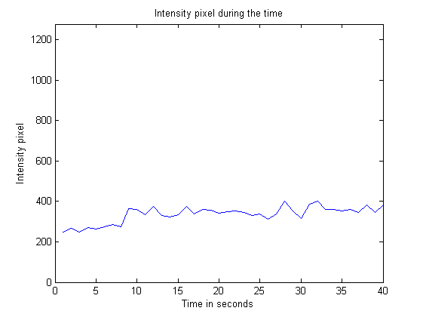
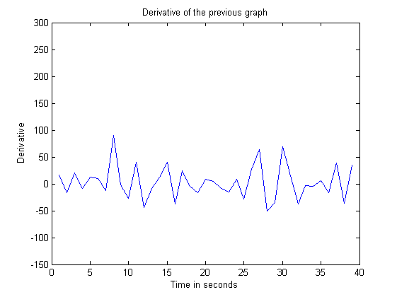
Algorithm description Injection time computation
Cancer tissue response
Non cancer tissue response
Algorithm:
Initialization: Injection time = 4; threshold = val;
for (i ; i < 10(25% of first points) ; i++)
if (derivative(i) > threshold)
Injection time = i;
break;
end
end
Cancer tissue derivative response
Simple
threshold
Impossible to find the parameter !!!
Injection time

Slide 9
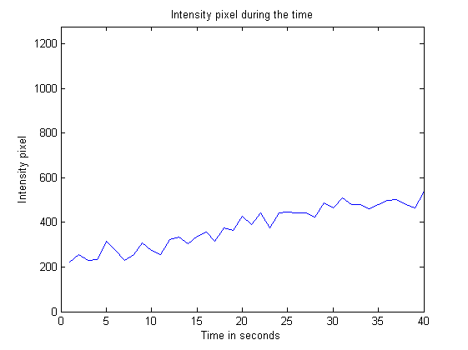
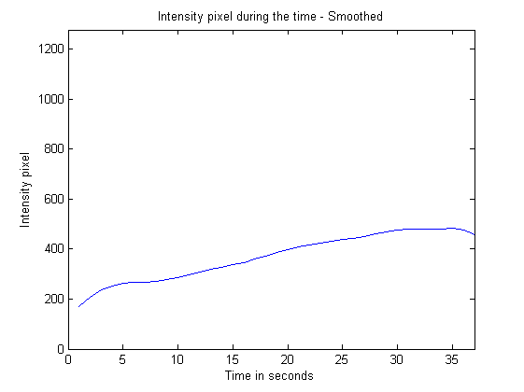
Algorithm description maximum computation – global maxima
for (i;i<all points;i++)
find max;
end
Smooth the curve to be less sensitive to the noise

Slide 10
Algorithm description maximum computation – Local maxima
for (i;i<15;i++)
find max;
end

Slide 11
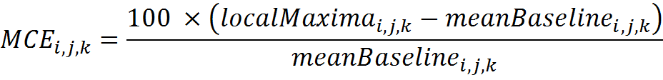
Algorithm description maximum contrast enhancement parameter
Compute mean value between the first point and the moment of the injection
Use the local maxima to compute the Maximum contrast as follow:
Where:
i and j are the index of the pixel p(i , j) considered
k is the index the slice considered

Slide 12
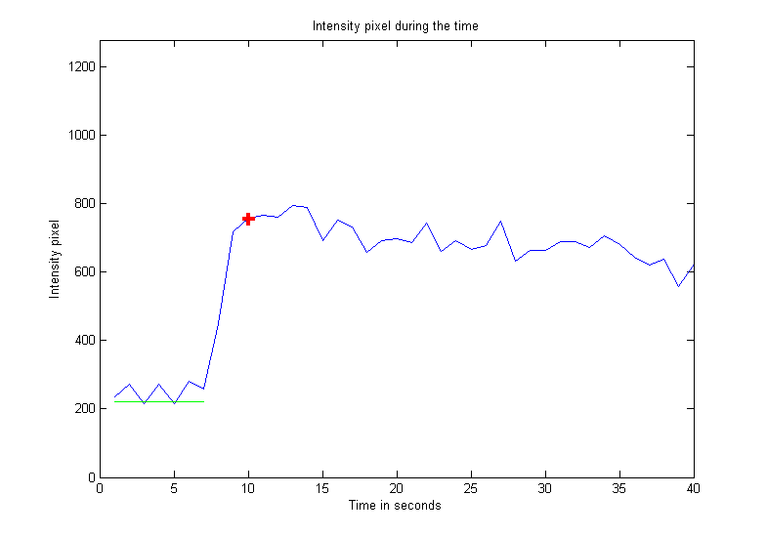
Algorithm description maximum contrast enhancement parameter
Where:
i and j are the index of the pixel p(i , j) considered
k is the index the slice considered
Local Maxima
Mean value of the baseline

Slide 13
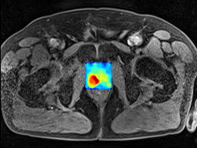
Algorithm description maximum contrast enhancement parameter
MCE result

Slide 14
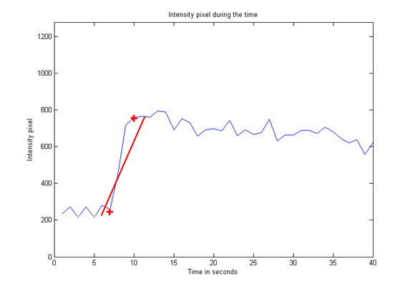
Algorithm description Wash-in parameter
Curve fitting in least squares sense between:
Injection time
Global maxima
Global maxima
Injection time

Slide 15
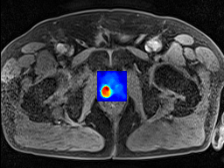
Algorithm description Wash-in parameter
Wash – In result

Slide 16
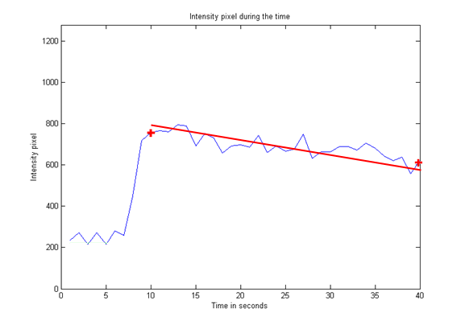
Algorithm description Wash-out parameter
Curve fitting in least squares sense between:
Local maxima
Last point
Last point
Local maxima

Slide 17
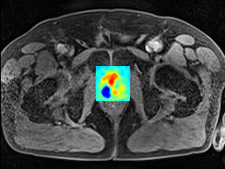
Algorithm description Wash-out parameter
Wash – Out result

Slide 18
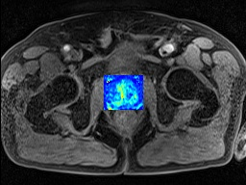
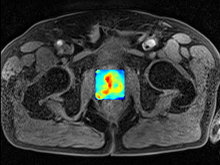
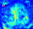
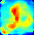
Algorithm description Post – processing
Apply median filter on parametric image

Slide 19
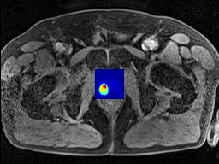
Algorithm description Combination of parametric images
Combination of the three parametric images
Where:
i and j are the index of the pixel p(i , j) considered
k is the index the slice considered

Slide 20
Outline
Introduction
Algorithm description
RESULTS
Improvements

Slide 21
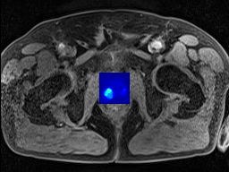

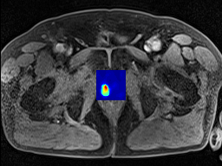
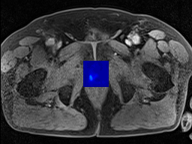
Results Patient 313 – without muscle normalization
Slice 10
Slice 11
Slice 12
Slice 13

Slide 22
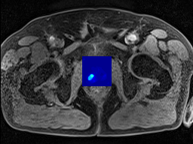
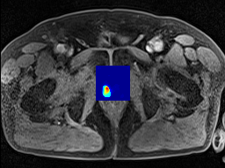
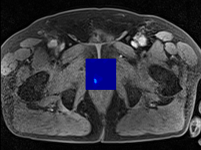
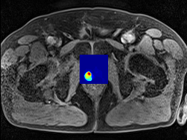
Results Patient 313 – with muscle normalization
Slice 10
Slice 11
Slice 12
Slice 13

Slide 23
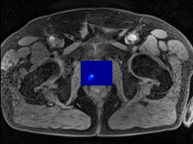

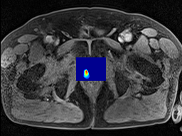
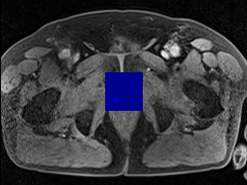
Results Patient 313 – with correction
Slice 10
Slice 11
Slice 12
Slice 13

Slide 24
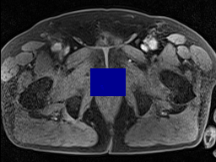
Results Patient 313 – with correction and normalization
Slice 10
Slice 11
Slice 12
Slice 13

Slide 25
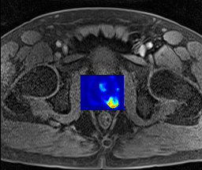
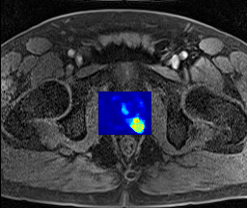
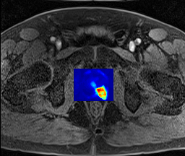
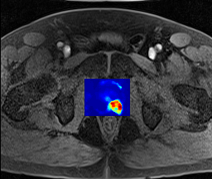
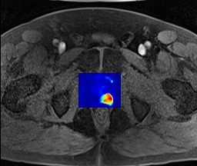
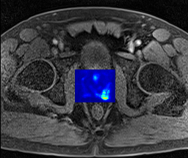
Results Patient 405 – without muscle normalization
Slice 16
Slice 11
Slice 12
Slice 13
Slice 14
Slice 15

Slide 26
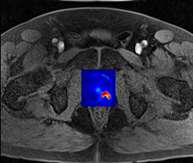
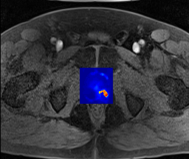
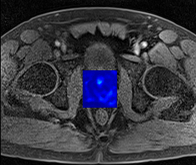
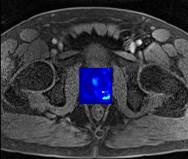
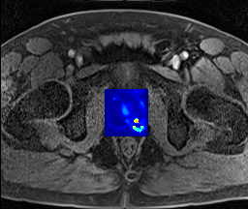
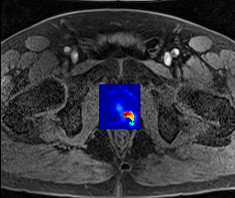
Results Patient 405 – with muscle normalization
Slice 16
Slice 11
Slice 12
Slice 13
Slice 14
Slice 15

Slide 27

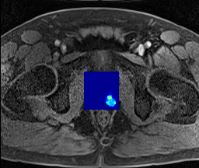
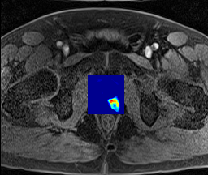
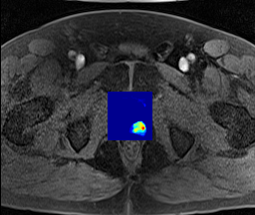


Results Patient 405 – with correction
Slice 16
Slice 11
Slice 12
Slice 13
Slice 14
Slice 15

Slide 28






Results Patient 405 – with correction and normalization
Slice 16
Slice 11
Slice 12
Slice 13
Slice 14
Slice 15

Slide 29





Results Patient 407 – without muscle normalization
Slice 8
Slice 9
Slice 13
Slice 10
Slice 11
Slice 12

Slide 30



Results Patient 407 – with correction
Slice 8
Slice 9
Slice 13
Slice 10
Slice 11
Slice 12

Slide 31






Results Patient 409 – without muscle normalization
Slice 6
Slice 7
Slice 8
Slice 9
Slice 11
Slice 10

Slide 32






Results Patient 409 – with muscle normalization
Slice 6
Slice 7
Slice 8
Slice 9
Slice 11
Slice 10

Slide 33




Results Patient 409 – with correction
Slice 6
Slice 7
Slice 8
Slice 9
Slice 11
Slice 10

Slide 34
Outline
Introduction
Algorithm description
Results
IMPROVEMENTS

Slide 35
Improvements
Better method to fit the data
Possibilities to apply some corrections with a pre-knowledge of values taken by parametric images to allow a better normalization
Better combination between all images

